Slide 1
Chapter 6
Concurrency: Deadlock and Starvation

Slide 2
Deadlock
Permanent blocking of a set of processes that either compete for system resources or communicate with each other
A set of processes is deadlocked when each process is blocked awaiting an event that can only be triggered by another blocked process
Permanent and no efficient solution

Slide 3
Deadlock - Example

Slide 4
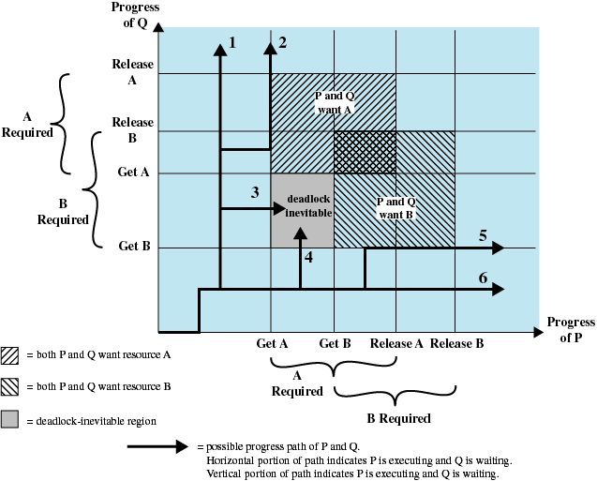
Deadlock - Example
Fatal region

Slide 5
Execution Path
Q acquires B and then A and then releases B and A. P will be able to acquire both resources.
Q acquires B and then A. P executes and blocks on request for A. Q resumes and then releases B and A. P will be able to acquire both resources when it resumes execution.

Slide 6
Execution Path
Q acquires B and then P acquires A. As execution proceeds, Q and P will block each other  deadlock.
P acquires A and then Q acquires B. As execution proceeds, Q and P will block each other  deadlock.

Slide 7
Execution Path
P acquires A and then B. Q executes and blocks on a request for B. P resumes and releases A and B. Q will be able to acquire both resource when it resumes execution.
P acquires A and then B and then releases A and B. Q will be able to acquire both resources when it continues execution.

Slide 8
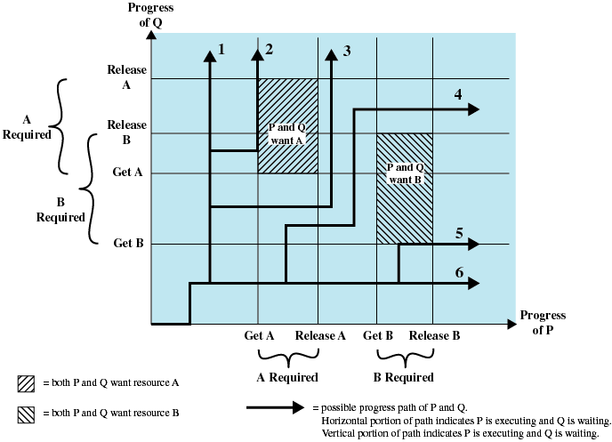
Deadlock – Example (No deadlock)

Slide 9
Resource Categories
Reusable Resources
Used by only one process at a time and not depleted by that use – will be releases for reuse
Examples: processors, I/O channels, main and secondary memory, devices, and data structures such as files, databases, and semaphores
Deadlock occurs if each process holds one resource and requests the other

Slide 10
Deadlock - Example
Deadlock occurs if the multiprogramming system interleaves the execution: p₀ p₁ q₀ q₁ p₂ q₂

Slide 11
Example of Deadlock
Space is available for allocation of 200KB, and the following sequence of events occur
Deadlock occurs if both processes progress to their second request
P₁
…
Request 80KB;
…
Request 60KB;
P₂
…
Request 70KB;
…
Request 80KB;

Slide 12
Resource Categories
Consumable Resources
Can be created (produced) and destroyed (consumed)
Examples: interrupts, signals, messages, and information in I/O buffers
Deadlock may occur if a Receive message is blocking

Slide 13
Example of Deadlock
Deadlock occurs if receive is blocking
May take a rare combination of events to cause deadlock → a program could be in use for a long period before deadlock occurs.
P₁
…
Receive(P₂);
…
Send(P₂, M₁);
P₂
…
Receive(P₁);
…
Send(P₁, M₂);

Slide 14
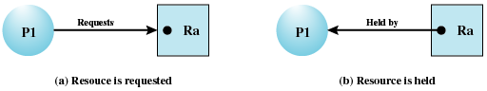
Resource Allocation Graph
A directed graph that depicts a state of the system of resources and processes
The edge directed from a process to a resource indicates a resource has been requested by the process
A dot in resource node indicates an instance of the resource

Slide 15
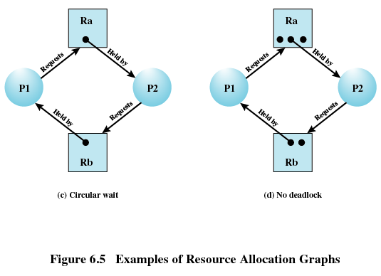
Resource Allocation Graph
Deadlock

Slide 16
Conditions for Deadlock
Mutual exclusion
Only one process may use a resource at a time
Hold-and-wait
A process may hold allocated resources while awaiting assignment of others
No preemption
No resource can be forcibly removed from a process holding it

Slide 17
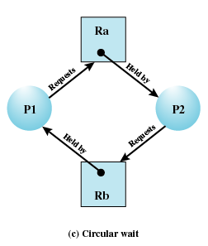
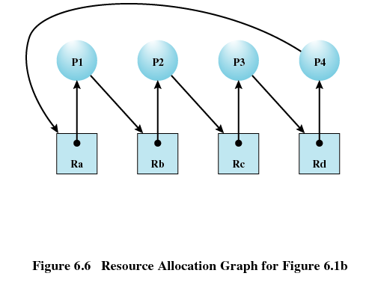
Conditions for Deadlock
Circular wait
A closed chain of processes exists, such that each process holds at least one resource needed by the next process in the chain

Slide 18
Possibility of Deadlock
Mutual Exclusion
No preemption
Hold and Wait
Deadlock may occur
Mutual Exclusion
No preemption
Hold and Wait
Deadlock occurs
Circular Wait

Slide 19
Deadlock
Three approaches dealing with deadlock:
Deadlock prevention
adopt a policy that eliminates one of the conditions
Deadlock avoidance
make the appropriate dynamic choices based on the current state of resource allocation
Deadlock detection
attempt to detect the presence of deadlock and take action to recover

Slide 20
Deadlock Prevention
Design a system in such a way that the possibility of deadlock is excluded
Two methods:
Indirect prevention
Prevent the occurrence of one of the three deadlock conditions
Direct prevention
Prevent the occurrence of circular wait

Slide 21
Deadlock Prevention
Mutual Exclusion
If required, must be supported by the operating system.
Example, file can be accessed by multiple processes for reading, but only exclusive access for writing is allowed.

Slide 22
Deadlock Prevention
Hold and Wait
Require a process requests all of its required resources at one time. It’s inefficient.
A process may be held up a long time waiting for all resources requested
Resources allocated to a process may remain unused for a considerable period
A process may not know in advance all the resources it will require

Slide 23
Deadlock Prevention
No Preemption
A process holding certain resources is denied a further request, must release resource and request again
OS may preempt a process to require it releases its resources

Slide 24
Deadlock Prevention
Circular Wait
Define a linear ordering of resource types
A process that allocated resource of type R may request only resources following R in the ordering
Ri precedes Rj (i < j), if process A has acquired Rj, it cannot request Ri

Slide 25
Deadlock Avoidance
Deadlock prevention: constrain resource requests to prevent at least one of the four conditions of deadlock  inefficient
Deadlock avoidance: allow three necessary conditions but decision is made to assure that the deadlock point is never reached

Slide 26
Deadlock Avoidance
A decision is made dynamically whether the current resource allocation request will, if granted, potentially lead to a deadlock
Requires knowledge of future process request

Slide 27
Two Approaches to Deadlock Avoidance
Resource Allocation Denial
Do not grant an incremental resource request to a process if this allocation might lead to deadlock
Process Initiation Denial
Do not start a process if its demands might lead to deadlock

Slide 28
Resource Allocation Denial
Referred to as the Banker’s Algorithm
State of the system is the current allocation of resources to processes
Safe state is where there is at least one sequence of resource allocations that does not result in deadlock
Unsafe state is a state that is not safe

Slide 29
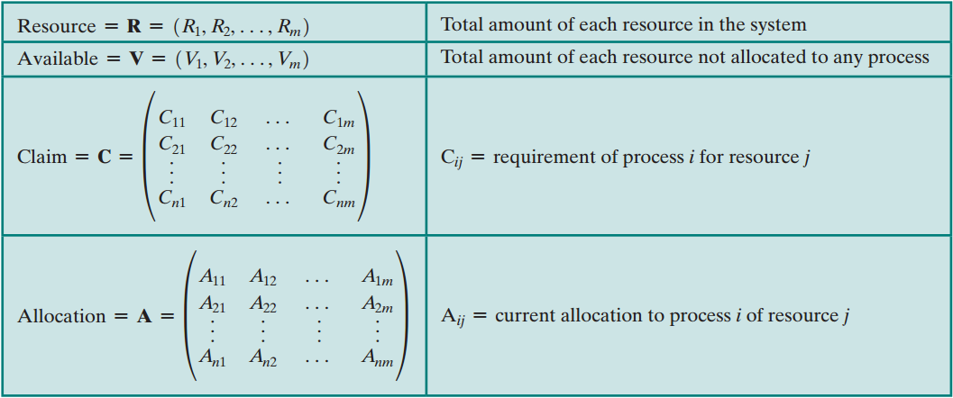
Determination of a Safe State

Slide 30
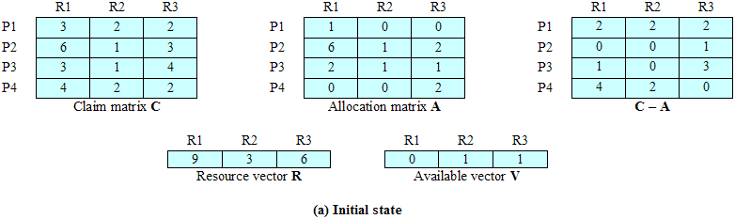
Determination of a Safe State

Slide 31
Determination of a Safe State
Can any of the four processes run to completion with the resources available?
OR
Can the different between the maximum requirement and current allocation for any process be met with the available resources?

Slide 32
Determination of a Safe State

Slide 33
Determination of a Safe State
C_{ij} = requirement of process i for resource j
A_{ij} = current allocation to process i of resource j
The condition to be met for process i is
C_{ij} – A_{ij} ≤ V_{j} for all j

Slide 34
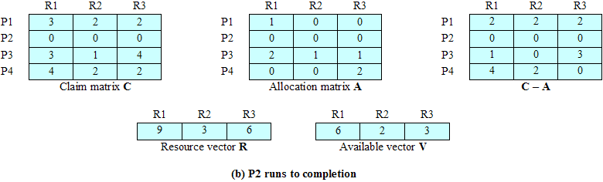
Determination of a Safe State

Slide 35
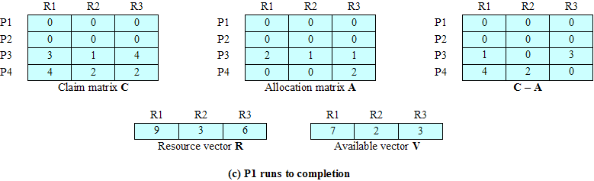
Determination of a Safe State

Slide 36
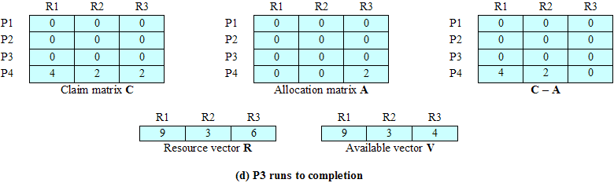
Determination of a Safe State
The initial state is safe state.

Slide 37
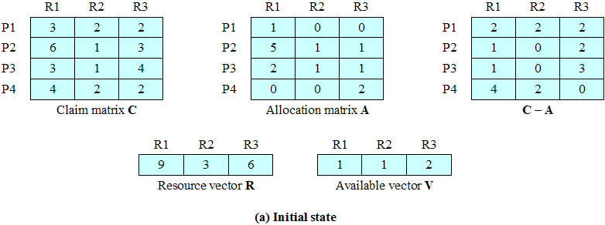
Determination of a Safe State
If P1 requests one additional unit of R1 and R3, and assume that the request is granted. Is the resulting state safe?

Slide 38
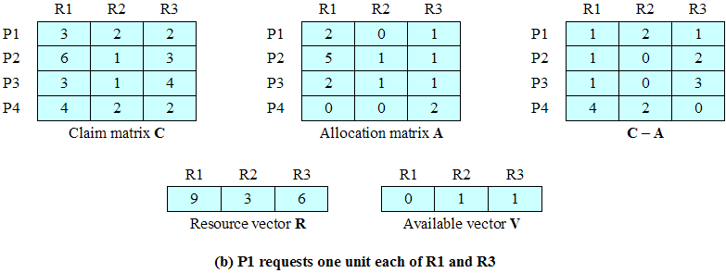
Determination of a Safe State
The resulting state is not safe. Thus, the request by P1 should be denied and P1 should be blocked.

Slide 39
Deadlock Avoidance – Advantages
It is not necessary to pre-empt and rollback processes, as in deadlock detection
It is less restrictive than deadlock prevention

Slide 40
Deadlock Avoidance - Restrictions
Maximum resource requirement must be stated in advance
Processes under consideration must be independent; no synchronization requirements
There must be a fixed number of resources to allocate
No process may exit while holding resources

Slide 41
Deadlock Avoidance – Example 1
Total resources: R1=7 R2=5 R3=8 R4=5
 | Max. Requirement |  |  |  |  | Allocated
 | R1 | R2 | R3 | R4 |  | R1 | R2 | R3 | R4
P1 | 3 | 2 | 1 | 4 |  | 1 | 0 | 1 | 1
P2 | 0 | 2 | 5 | 2 |  | 0 | 1 | 2 | 1
P3 | 5 | 1 | 0 | 3 |  | 4 | 0 | 0 | 2
P4 | 1 | 5 | 3 | 0 |  | 0 | 2 | 1 | 0
P5 | 3 | 0 | 3 | 3 |  | 1 | 0 | 3 | 0

Slide 42
Deadlock Avoidance – Example 2
Total resources: R1=5 R2=4 R3=5 R4=6
 | Max. Requirement |  |  |  |  | Allocated
 | R1 | R2 | R3 | R4 |  | R1 | R2 | R3 | R4
P1 | 2 | 0 | 2 | 3 |  | 2 | 0 | 1 | 0
P2 | 1 | 2 | 1 | 1 |  | 0 | 0 | 0 | 1
P3 | 0 | 4 | 3 | 6 |  | 0 | 1 | 1 | 2
P4 | 3 | 1 | 3 | 0 |  | 1 | 0 | 1 | 0
P5 | 2 | 4 | 3 | 3 |  | 1 | 1 | 1 | 1

Slide 43
Deadlock Strategies
Deadlock prevention strategies are very conservative
limit access to resources by imposing restrictions on processes
Deadlock detection strategies do the opposite
resource requests are granted whenever possible

Slide 44
Deadlock Detection Algorithms
A check for deadlock can be made as frequently as each resource request or, less frequently, depending on how likely it is for a deadlock to occur
Advantages:
it leads to early detection
the algorithm is relatively simple
Disadvantage is frequent checks consume considerable processor time

Slide 45
Deadlock Detection Steps
Mark each process that has a row in the Allocation matrix of all zeros
Initialize a temporary vector W to equal the Available vector

Slide 46
Deadlock Detection Steps
Find an index i such that process i is currently unmarked and the ith row of Q is less than or equal to W. Q_{ik} ≤ W_{k} for 1 ≤ k ≤ m. If no such row is found, terminate the algorithm.
If such row is found, mark process i and add the corresponding row of the allocation matrix to W. W_{k} = W_{k} + A_{ik} for 1 ≤ k ≤ m. Return to step 3.

Slide 47
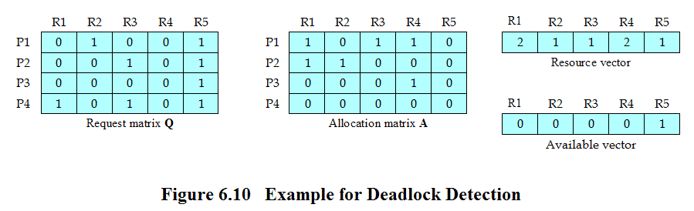
Deadlock Detection Steps
Q_{ij} = the amount of resources of type j requested by process i
Mark P4, because P4 has no allocated resources
Set W = (0 0 0 0 1)

Slide 48
Deadlock Detection Steps
The request of P3 is less than or equal to W, mark P3 and set W = W + (0 0 0 1 0) = (0 0 0 1 1)
No other unmarked process has a row in Q that is less than or equal to W. Terminate the algorithm.

Slide 49
Deadlock Recovery Strategies
Abort all deadlocked processes
Back up each deadlocked process to some previously defined checkpoint, and restart all process
Original deadlock may occur
Successively abort deadlocked processes until deadlock no longer exists. Deadlock detection algorithm must be reinvoked after each abortion

Slide 50
Deadlock Recovery Strategies
Successively preempt resources until deadlock no longer exists. Deadlock detection algorithm must be reinvoked after each preemption

Slide 51
Deadlock Recovery Strategies
Selection criteria for strategies 3 and 4
Least amount of processor time consumed so far
Least number of lines of output produced so far
Most estimated time remaining
Least total resources allocated so far
Lowest priority

Slide 52
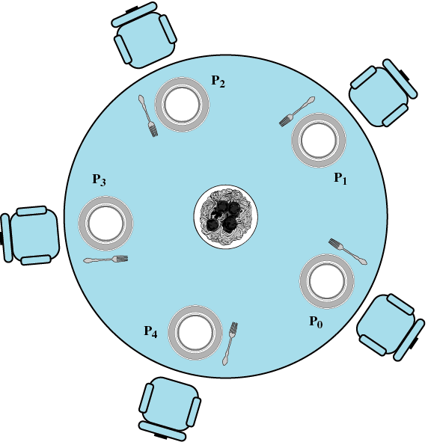
Dining Philosophers Problem

Slide 53
Dining Philosophers Problem
Each philosopher requires two forks to eat
No two philosophers can use the same fork at the same time – mutual exclusion
No philosopher must starve to death (avoid deadlock and starvation)

Slide 54
Solution 1 Using Semaphore

Slide 55
Solution 2 Using Semaphore

Slide 56
Solution Using Monitor

Slide 57
Solution Using Monitor

Slide 58
Solution Using Monitor

